Slide 1
to the 2019 BTAG Summit
Financial Aid Presentation
Leslie King, Director of Financial Aid, Hostos Community College
Margaret Nelson, Director of Financial Aid, Bronx Community College
Cristina Ortiz-Harvey, Director of Financial Aid, Guttman Community College
Vera Senese, Director of Financial Aid, Lehman College
Notes:
Vera Will open the presentation

Slide 2
Introduction
Access to financial aid is one of the key determining factors that impacts student enrollment, retention, and graduation. In this session, four Financial Aid Directors will provide comprehensive information about what both students/advisors need to be aware of when they are working with transfer students at all of the BTAG colleges.
Learning Outcomes:
Participants will learn how to empower transfer students with financial aid Information they need to know to have a smooth transition into the four year program
Participants will learn how to empower transfer students with Actions needed to secure their financial aid in order to continue their study
Participants will become “Partners” with the Financial Aid Offices
Notes:
Vera will:
Introduce all presenters
Presentation
Give them the time limits
30 minute presentation
10 minutes for questions at the end
Give them a quick overview of what we will be presenting – information and process can be complicated and our students often have complicated lives.
Things to Know
Things to Do

Slide 3
BTAG SUMMIT 2019
Financial Aid
Learning Outcomes for Academic Advisors
Discuss important INFORMATION both transfer student/advisors should know
Discuss important ACTIONS transfer student need to do
Questions & Answers
Notes:
Vera: Will review the agenda with the audience

Slide 4
Let’s Talk Transfer Students’ Statistics
Pell Grant Lifetime Eligibility Units (LEU)- The amount of Federal Pell Grant funds a student may receive over his or her lifetime is limited to be the equivalent of six years of Pell Grant funding.
The average LEU students used before transferring is approximately 350%
How many Lehman students run out of Fed/State aid before they graduate?
13%-14% of our transfer students arrive on their campuses with 1-3 years of remaining Pell eligibility
1% arrive with a year or less or remaining Pell eligibility
Pell LEU = 12 semesters of FT eligibility = 600% usage
Notes:
Cristina will:
Present on LEU and Statistics

Slide 5
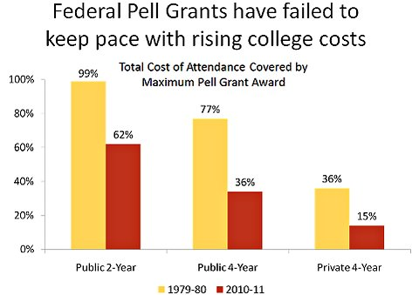
Things to know: Federal Aid - Limits
Limits – will transfer students have enough financial aid to cover their remaining study for a four year degree after the student has earned an Associate Degree?
Federal Financial Aid:
Year-Round Pell Grant (Known as 150% Pell)
Students can receive Pell for the entire year (Summer, Fall, and Spring)
Thus students can earn their degree faster
Federal Direct Loan Annual Limits
Federal Direct Subsidized Federal Direct Unsubsidized
Freshmen $3,500 - $6,000
Sophomore $4,500 - $6,000
Junior/Senior $5,500 - $7,000
150% Direct Subsidized Loan Limit (SULA)- Total of 6 years
2 Year Undergraduate has a Max of 3 years
This means that a student only has 3 years of
Subsidized eligibility for their senior college
Notes:
Cristina and Leslie:
Cristina- Will discuss year round pell
Leslie – Will discuss Federal Direct Loan limits and SULA

Slide 6
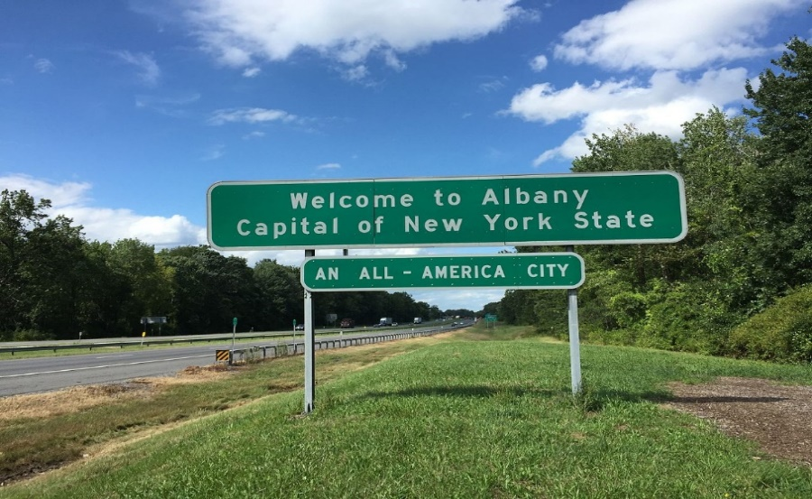
Things to know: N.Y. State Aid-Limits will transfer students have enough N.Y State Aid to cover their remaining study for a four year degree after earning an Associate Degree.
New York State Financial Aid
TAP Points
48 TAP Points
Satisfactory Academic Progress requirements
Students are expected to make progress and pursuit to receive TAP
Effect of remediation
Excelsior Scholarship
30 credits requirements (summer/fall/spring) with NO gap
Declaration of Major at 60 credits
Students must declare a major at 60 credits. Otherwise student loses TAP/Pell award
College Discovery (CD) to SEEK transfers
Students must file a transfer application to have their state aid transferred to a four year college
Students should work with the specialized program office to ensure proper transfer
ASAP to ACE transfers
What should students know??????
Notes:
Leslie will present on NYS Aid limits

Slide 7
Things Students Should Do: Application process
Negative Service Indicators
Complete Exit interviews for Direct Loans from
the prior college
Resolve Bursar holds
Any other holds, etc.
Transcripts
Provide all official academic transcript(s) for transfer credits
Declare a Major by 60 credits
Demographic Information on CUNYFirst
Update address, telephone number, email, bank account number, etc.
Notes:
Margaret Will present on Things to do (application)

Slide 8
Things Students Should do: Federal Application
Federal Aid
Make sure the student adds the correct college code (Lehman College: 007022) on the FAFSA application
If selected for Verification
Submit all required documents listed on their CUNYFirst “To Do List”
Documentation requirements may differ from each college
Dissolution of Family/Special Circumstances
Each college is subjected to requiring different
Professional Judgement for Independent Appeal
Special Income Adjustment
IRS issues
Must be resolved prior to awarding financial aid
Federal Direct Loan – Must complete a new Federal Loan Request Form
Notes:
Margaret Will present on Things to do (application) cont.

Slide 9
Things Students should do: NY State application
N Y State Aid
Student should update the TAP college code to (Lehman College: 1412) via the TAP change form
Submit all required documents listed on their CUNYFirst “To Do List”
Register for courses required for their
program of study
Register for a minimum of 12 credits per semester
Complete ALL their courses
Notes:
Margaret Will present on Things to do (application) cont.

Slide 10
Helpful “tips” for advisors what to look for
CUNYFirst checklists - especially for mid-year transfers
Always encourage/require students to check their “To Do” list
Negative Service Indicators – take care of past due balances
Application process
Change school codes on both Federal and NY State aid applications
File the correct applications (e.g. 19-20 vs. 18-19)
Submit the required verification documents (even if already submitted to a prior college)
Always take courses that not only count towards degree, but towards their major
Transfer credits may not always be evaluated by the time they transfer/multiple transcripts
Apply for graduation at community college
If student transfers with 60 credits, they should declare their major immediately (iDeclare)
Discuss/refer alternative financial aid and financial options.
Refer students to NSLDS and/or HESC to track Pell LEU and TAP Points.
When in doubt, contact the financial aid office!
Notes:
Cristina will present on Helpful Tips

Slide 11
Helpful Resources
Free Application Federal Student Aid (FAFSA) studentaid.ed.gov/FAFSA‎ 1.800.433.3243
HESC Website – https://www.hesc.ny.gov/ - 1-888-697-4372
CUNYFirst – https://cunyfirst.cuny.edu/
iDeclare at Lehman - http://www.lehman.edu/registrar/student-records.php 1.718.960.8255
FACTS – https://facts.cuny.edu/FinAid_EligibilityAudit/facts_search.jsp
National Student Loan Data Service (NSLDS) https://nslds.ed.gov/nslds/nslds_SA/ / 1-800-730-8913
Federal Direct Student Loans – https://studentloans.gov 1.800.557.7394
Alternative funding sources when students run out of Federal and/or NY State aid
Scholarships
Alternative/Private Loans
Payment Plans
Notes:
Cristina will present on helpful resources

Slide 12
Have questions? We have answers!
Vera Senese
Director of Financial Aid, Lehman College
Elvira.Senese@lehman.cuny.edu
Leslie King
Director of Financial Aid, Hostos Community College
Lking@hostos.cuny.edu
Margaret Nelson
Director of Financial Aid, Bronx Community College
Margaret.Nelson@bcc.cuny.edu
Cristina Ortiz-Harvey
Director of Financial Aid, Guttman Community College
Cristina.Ortiz-Harvey@Guttman.cuny.edu
Notes:
Team dance!

